Slide 1






Thynk Unlimited
SQL PROJECT
MUSIC STORE ANALYSIS
By Rohit Raj

Slide 2




Thynk Unlimited
OBJECTIVE
The objective of this analysis to help the music store and help them to grow their business
We will use SQL for the analysis

Slide 3


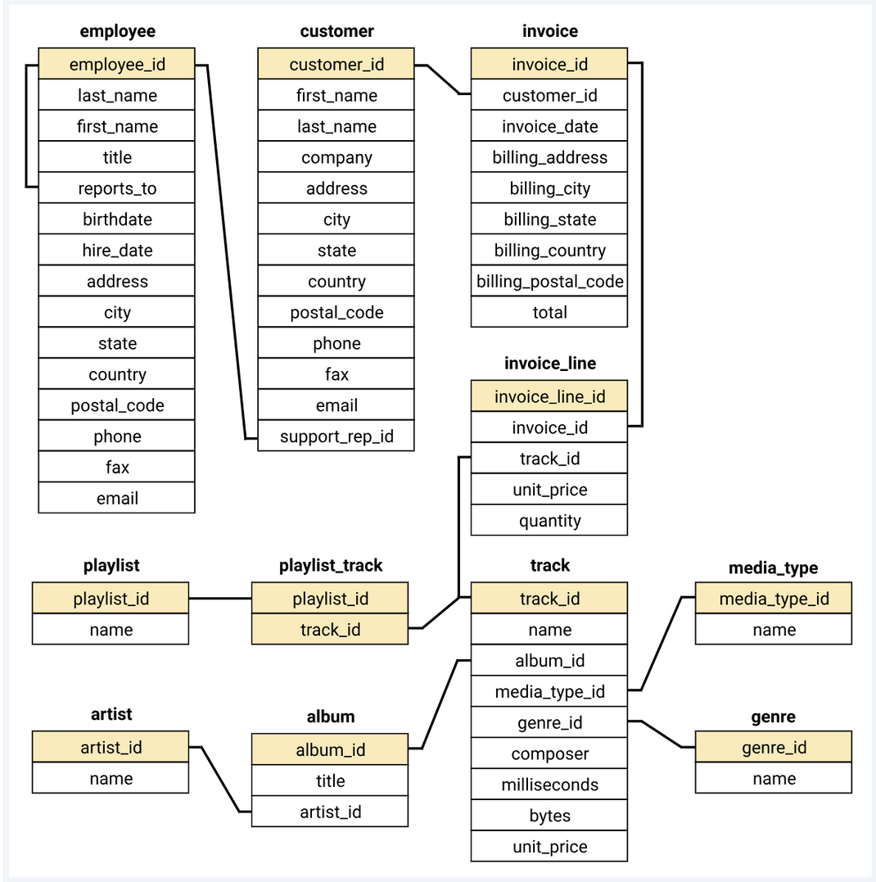

Thynk Unlimited
Content
DATASET SCHEMA

Slide 4
Thynk Unlimited
Home
About
Content
Others
LEVEL OF QUERIES
Easy
Medium
Advance
Include
select, group by, order by
Include
join, window function
Include
CTE (common table expression)

Slide 5
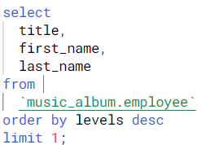
Thynk Unlimited
Who is the senior most employee based on job title?

Slide 6
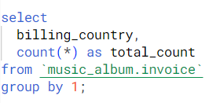
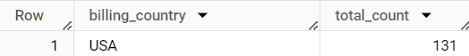
Which countries have the most Invoices?

Slide 7
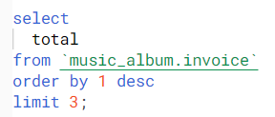
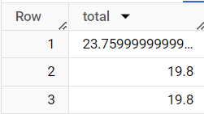
What are top 3 values of total invoice?

Slide 8
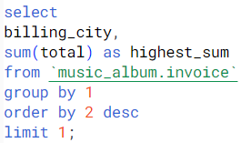
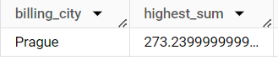
Which city has the best customers? We would like to throw a promotional Music Festival in the city we made the most money.
Write a query that returns one city that has the highest sum of invoice totals.
Return both the city name & sum of all invoice totals

Slide 9
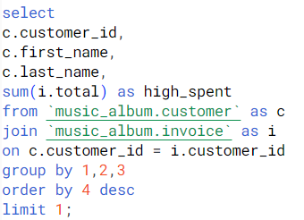
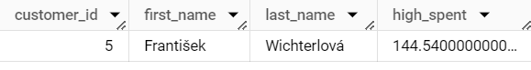
Who is the best customer? The customer who has spent the most money will be declared the best customer.
Write a query that returns the person who has spent the most money.

Slide 10
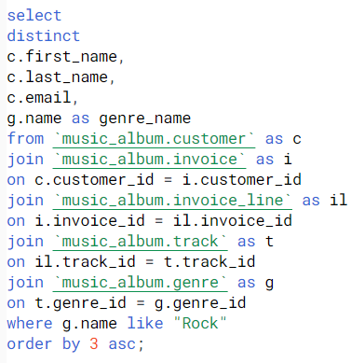
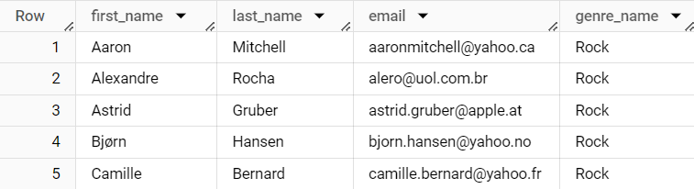
Write query to return the email, first name, last name, & Genre of all Rock Music listeners.
Return your list ordered alphabetically by email starting with A

Slide 11
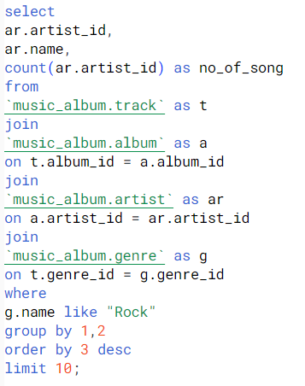
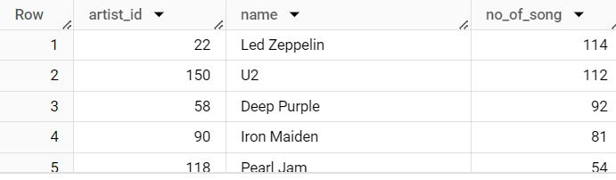
Let's invite the artists who have written the most rock music in our dataset.
Write a query that returns the Artist name and total track count of the top 10 rock bands

Slide 12
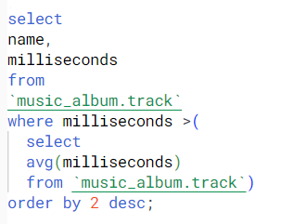
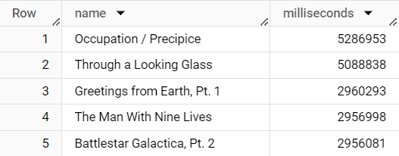
Return all the track names that have a song length longer than the average song length.
Return the Name and Milliseconds for each track. Order by the song length with the longest songs listed first.

Slide 13
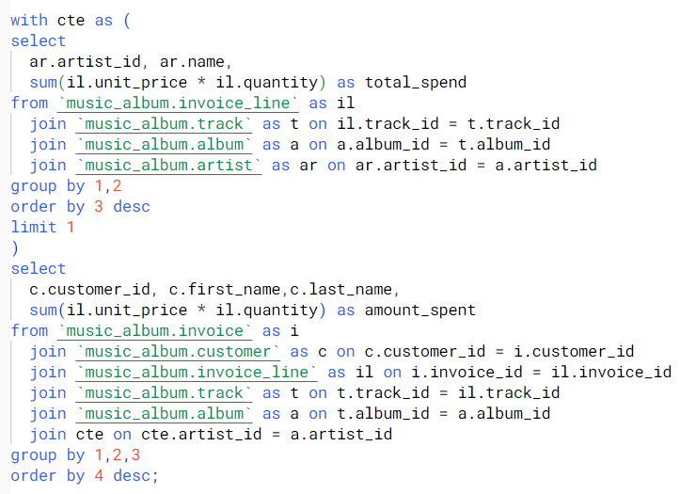
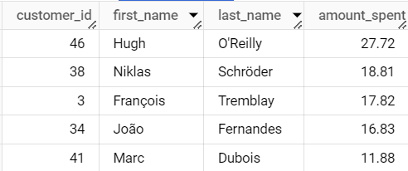
Find how much amount spent by each customer on artists? Write a query to return customer name, artist name and total spent

Slide 14
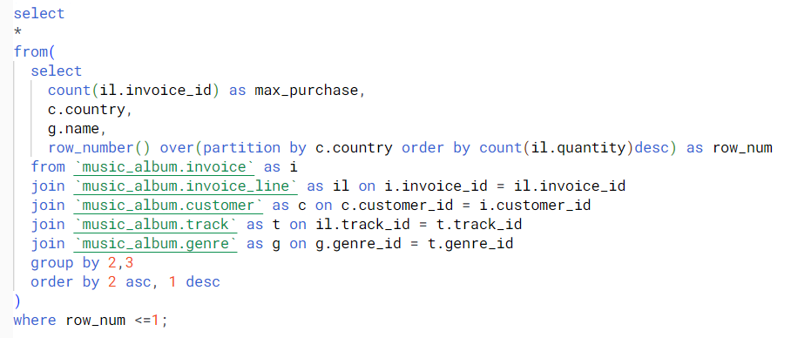
We want to find out the most popular music Genre for each country. We determine the most popular genre as the genre
with the highest amount of purchases. Write a query that returns each country along with the top Genre. For countries where
the maximum number of purchases is shared return all Genres.

Slide 15
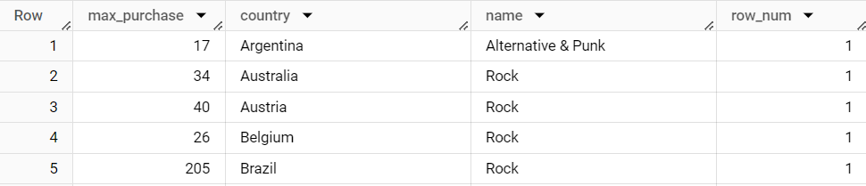

Slide 16
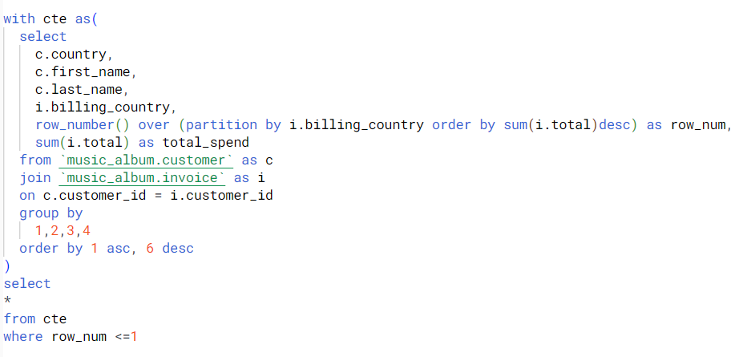
Write a query that determines the customer that has spent the most on music for each country.
Write a query that returns the country along with the top customer and how much they spent.
For countries where the top amount spent is shared, provide all customers who spent this amount.

Slide 17
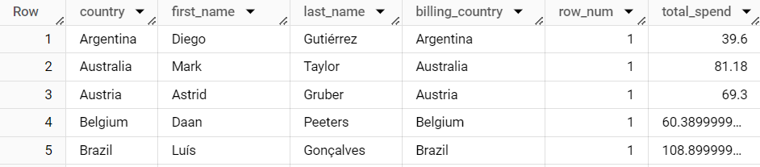

Slide 18


Thynk Unlimited
Home
About
Content
Others
INSIGHT
Mohan Madan is the senior most employee and his title is senior general manager
USA has the most invoice count
prague is the city which has the highest sum
Frantishek is the best customer
Argentina is the best billing country and the famous genre is Rock

Slide 19
You
Thynk Unlimited
Home
About
Content
Others
THANK

